Slide 1
Security and Authorizations

Slide 2
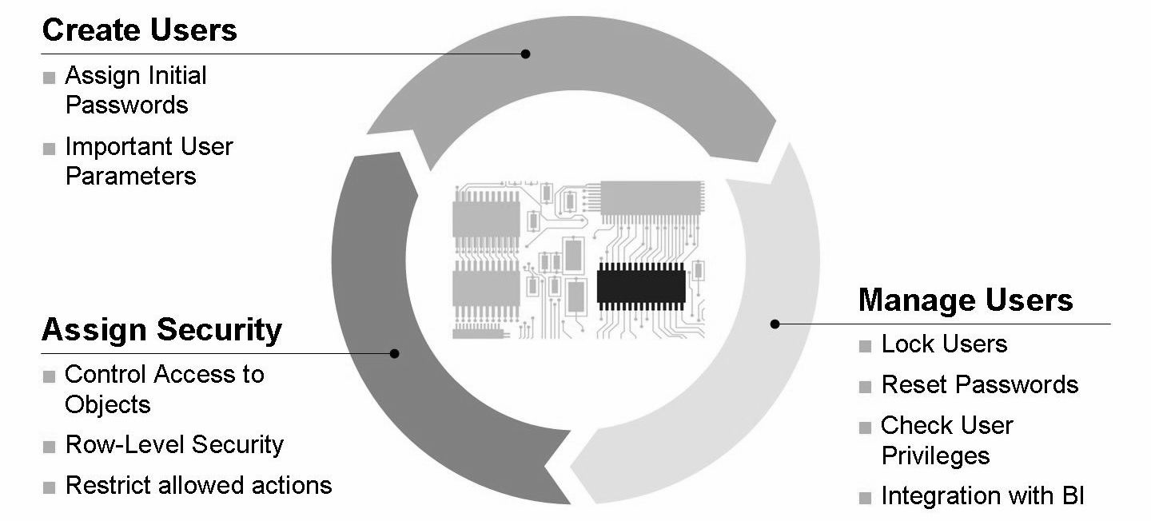
User Management and Security

Slide 3
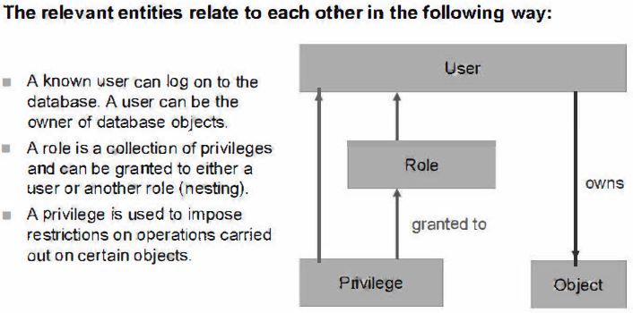
Relationships Between Entities

Slide 4
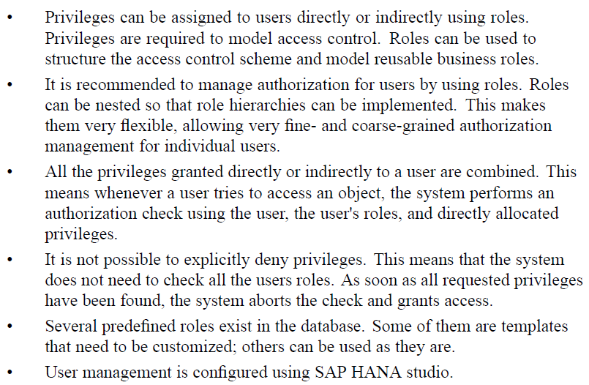

Slide 5
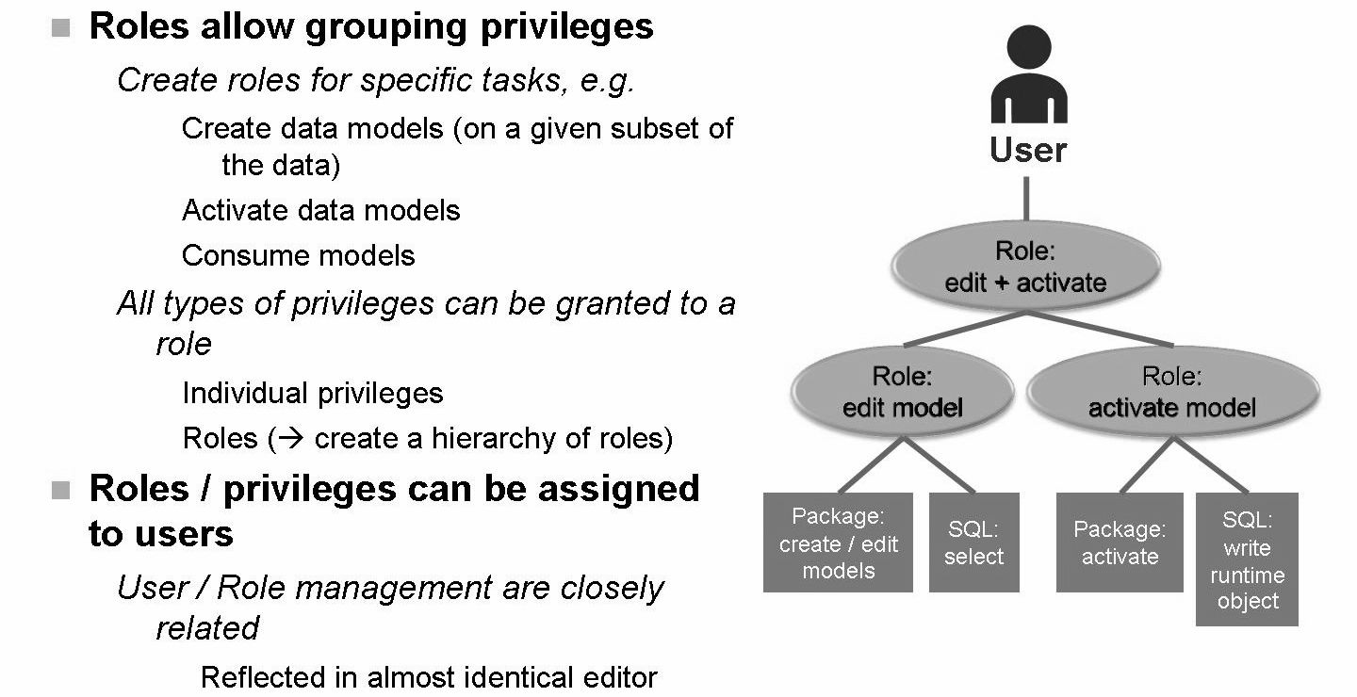

Slide 6
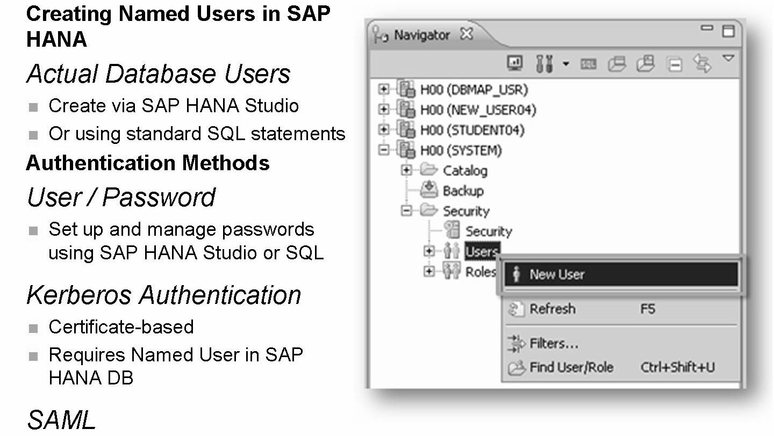
User and Role Concept

Slide 7
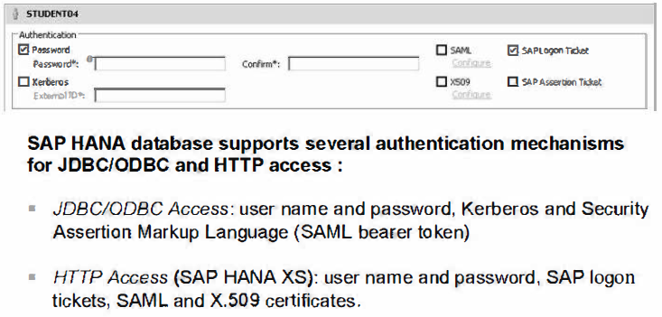
Authentication concept

Slide 8
Kerberos
SAP HANA supports the Kerberos protocol for single sign-on. It has been tested with Windows Active Directory Domain Kerberos implementation and MIT Kerberos network authentication protocol. The ODBC database client and the JDBC database client support Kerberos.
To implement this, you need to install the MIT Kerberos client software on the host of the SAP HANA database.
SAML
SAML, Security Assertion Markup Language, is the XML-based standard for communicating identity information between organizations. The primary function of SAML is to provide Internet Single Sign-On (SSO) for organizations. SAML is used to securely connect Internet applications that exist both inside and outside the organization's firewall.
SAML is a standard protocol for authentication
Generally speaking, Internet SSO is a secure connection that communicates identity and trust from one organization to another. For users, Internet SSO eliminates additional logins to external resources. For system administrators, it improves security and reduces costs.
– Requires a trusted 3rd party (identity provider) that can issue SAML assertions for clients (e.g. browser).

Slide 9
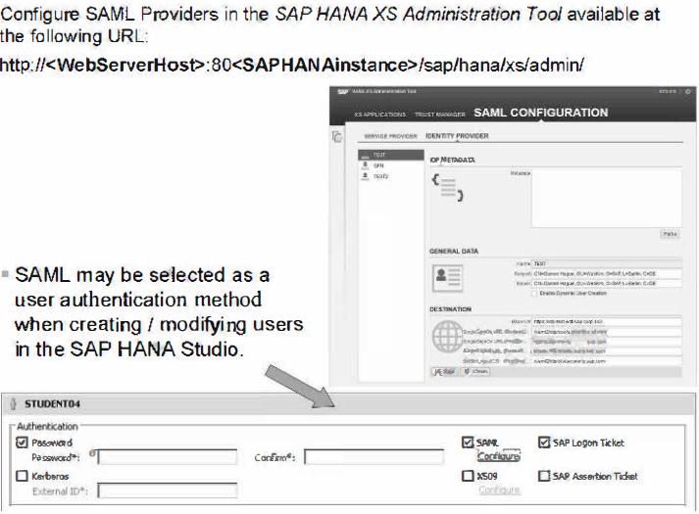

Slide 10
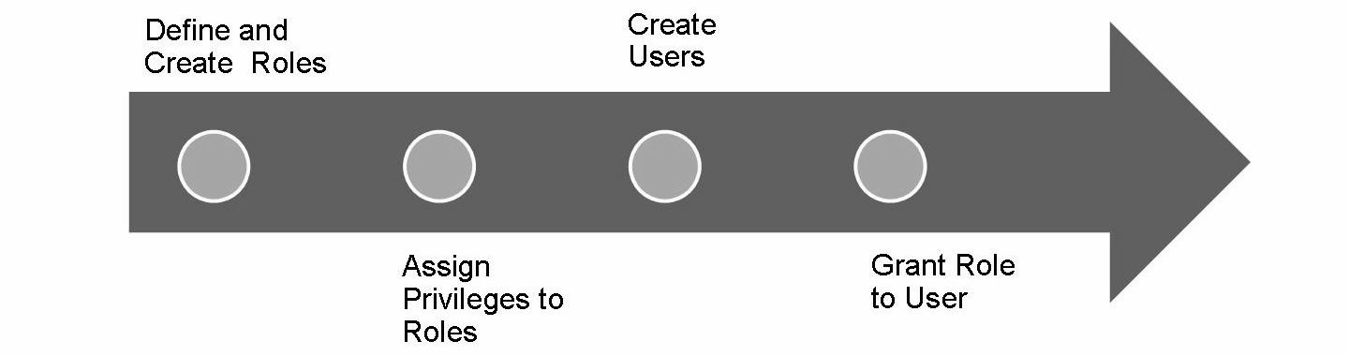
Managing Users and Roles

Slide 11
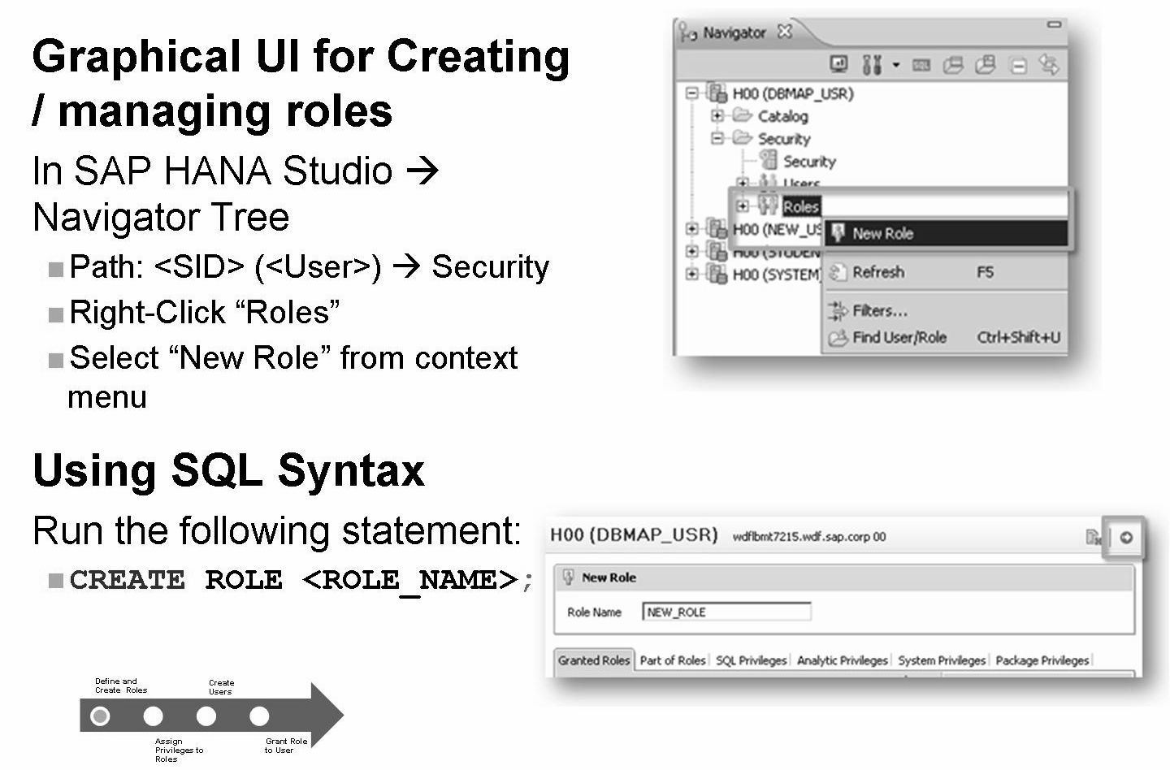
Creating Role using SAP HANA Studio

Slide 12
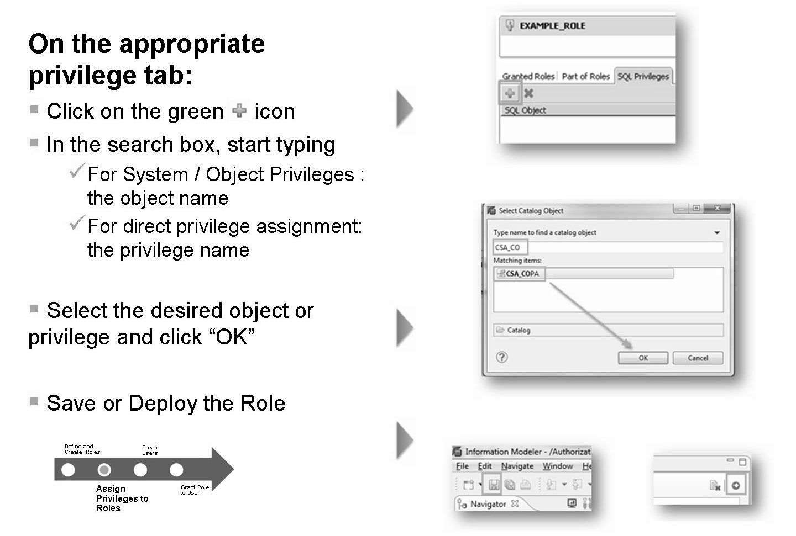
Assign Privileges to Roles

Slide 13
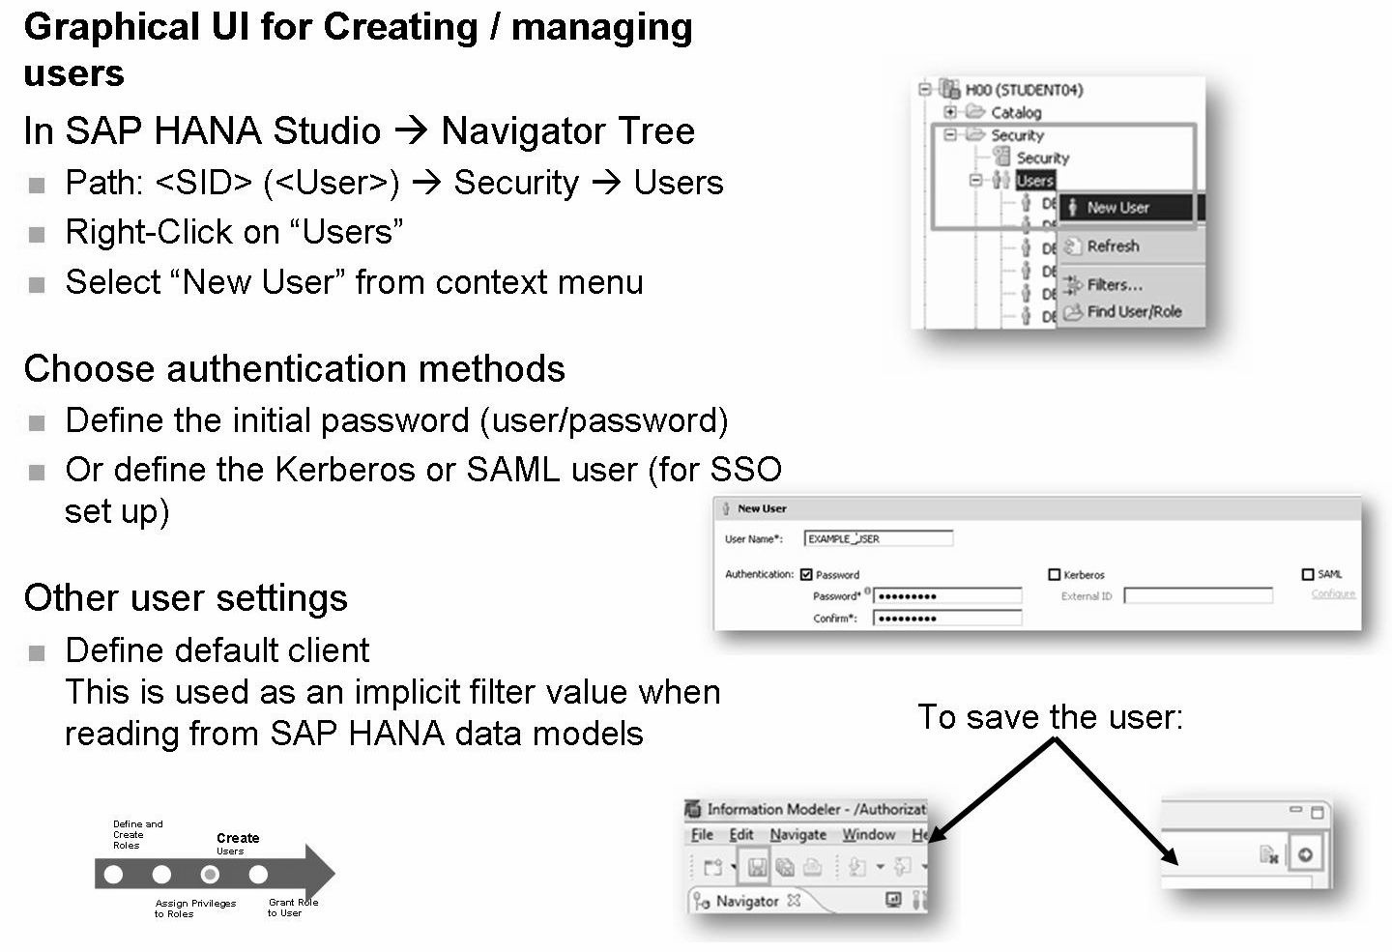
Create Users

Slide 14
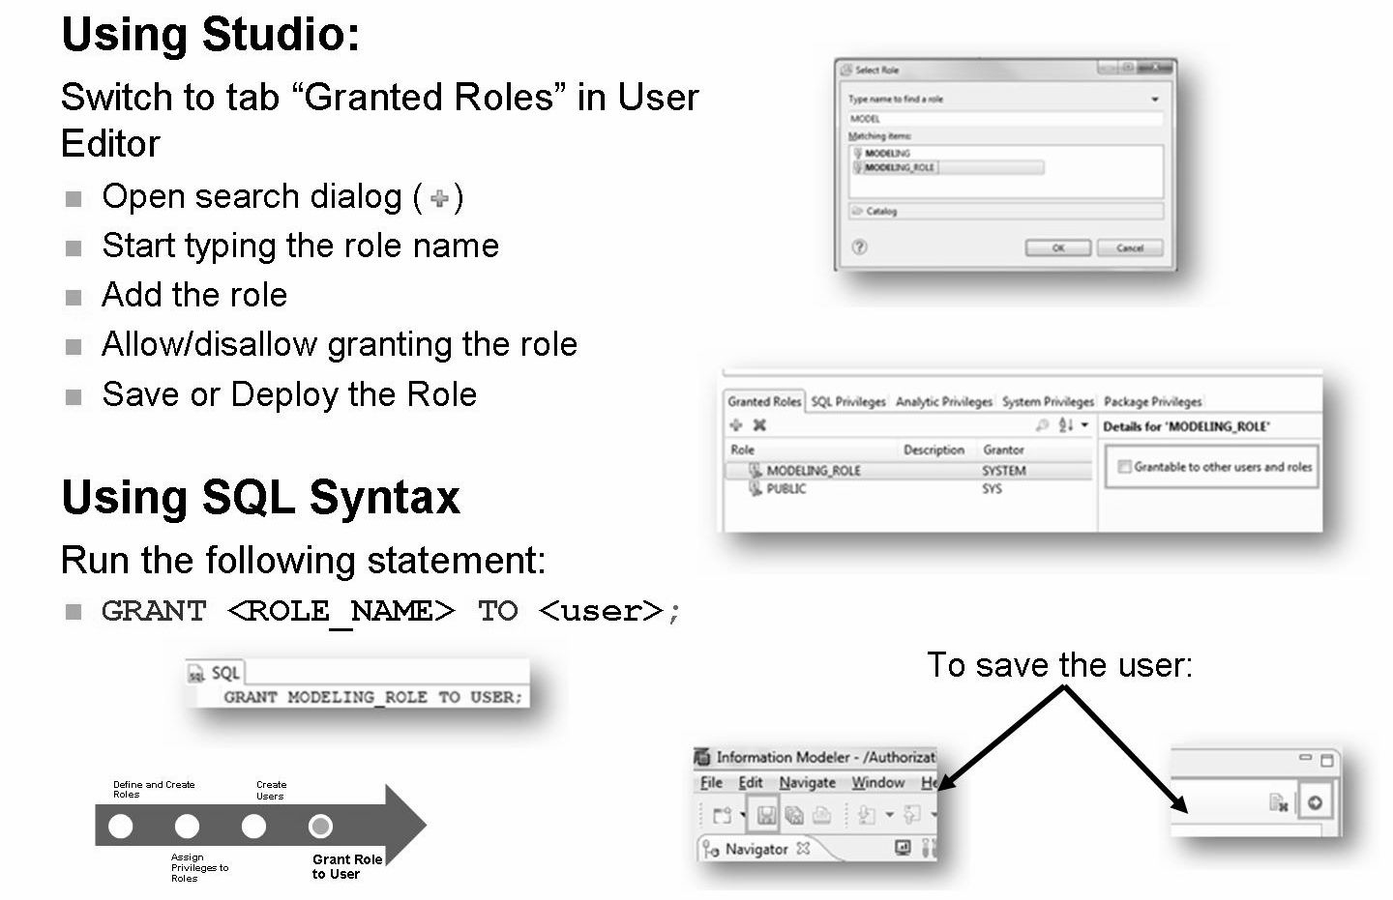
Grant Roles to User

Slide 15
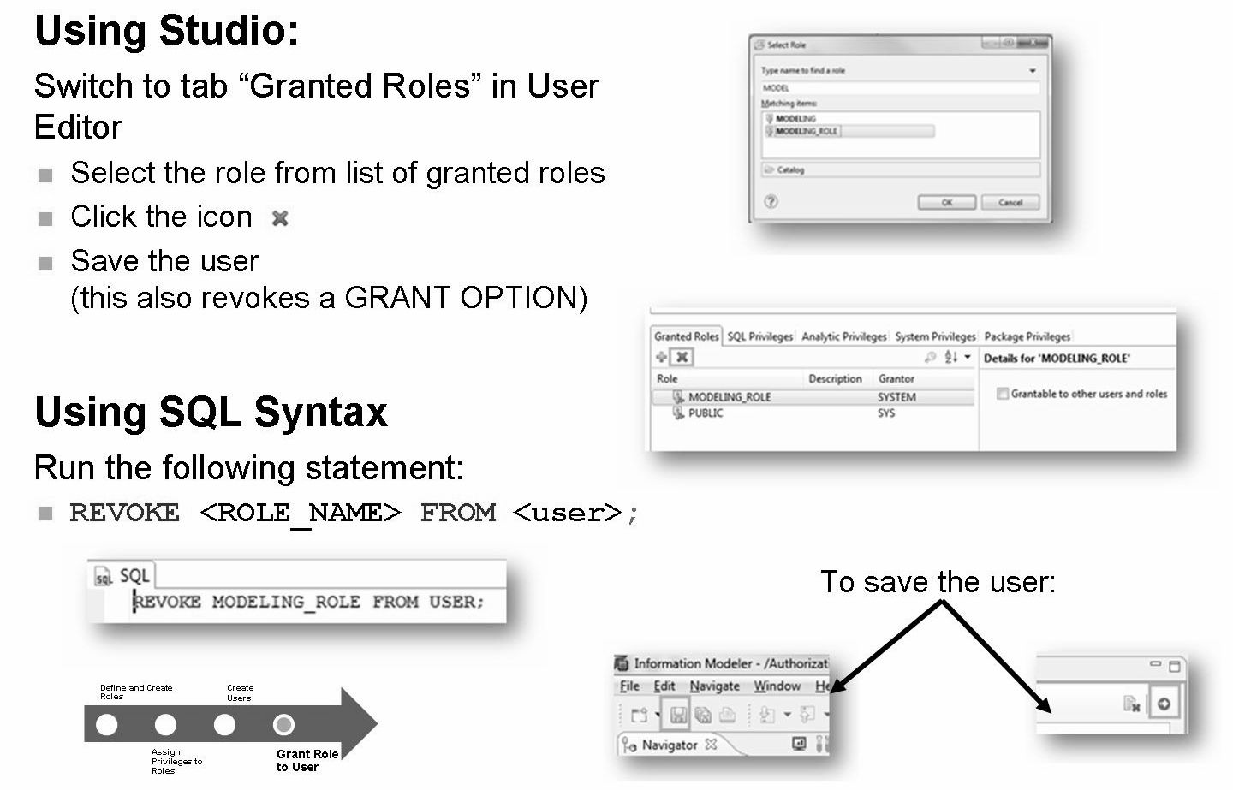
Revoke Roles from User

Slide 16
THANK YOU
Courtesy : SAP Labs Document -
HA 300 – SAP HANA Implementation and Modeling

